Slide 1
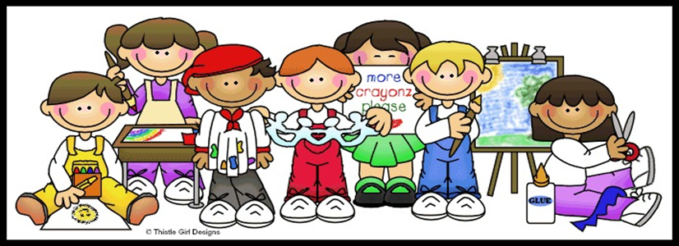
We look forward to working with you and your child in Year 2.

Slide 2
.
What is transition?
Transition is the change a child encounters moving from one familiar setting (including home) to another. Some children by the time they have reached school age may have experienced several transitions which will have helped them to adapt their thoughts, feelings and behaviour to meet new expectations. Some children may not have experienced several transitions so may find new transitions more difficult.
Transitions need continuity to provide the child with confidence, thereby feeling secure and making the process exciting. Remember if you are anxious about your child’s transition they will be too.
We want our children to experience a smooth
transition throughout their learning, so that the pace
and quality of learning are maintained to ensure that
children continue to make the very best progress.

Slide 3
Organisation of Year 2 Autumn 2022
Swifts – Miss Foster
Swallows– Mrs Prinold
Year 2 children in swifts and Swallows will enter and exit school through the middle door on the playground.

Slide 4
Morning Routines – Developing Independence
All classes have labelled pegs outside their classroom for the children to put their coats and PE bags.
Please encourage the children to bring PE kits into school each Monday and leave them in school until a Friday when they will then bring them home for washing.
Each classroom has a designated place for the children to keep their water bottle each day.

Slide 5
Reading
As in previous years the children will need to bring their book bags and reading diaries every day. Book bags should be in their drawers so that they are easily accessible during the day, rather than on their coat pegs.
Children will have a set of words to learn and two reading books that are their coloured band.
These books will be changed weekly by a member of staff but children can change these daily themselves.
Please make a comment in your child’s diary when they have read to you. We ask that you read everyday with your child for 10 minutes.
Each time your child moves up a book band a leaflet will be put into their diary to give you things to work on at home.
In preparation for Year 2 we would like all children to join in with the summer reading challenge.

Slide 6
Summer reading challenge – Gadgeteers

Slide 7
The Curriculum
From September your child will be working on the Key Stage 1 National Curriculum.
Core Subjects | Foundation Subjects
English (Reading, Writing and Speaking and Listening) including Phonics Maths Science | Physical Education (PE) History Geography Art Design & Technology PSHE (JIGSAW) Religious Education Music Computing

Slide 8
Topics and Educational Visits
Autumn Term
Topic: Let’s explore…
Visit: Residential Visit to Edgmond Hall
Visit: Blists Hill – Victorian school
Spring Term Topic: Let’s investigate…
Visit: Chester Zoo
Summer Term Topic: Inquiring minds…
Visit: Transport Museum

Slide 9
Assessment
KS1 Final Assessment
In May of Year 2 a final teacher assessment is made in Reading, Writing, (including SPaG), Mathematics and Science.

Slide 10
Any questions?
Please don't hesitate to contact the school office:
Email : A2116@taw.org.uk
Telephone: 01952 387860

